Slide 1
C.V/ RESUME WRITING
&
COVER LETTER
Presented by Ms. Maryam Ali Khan
Lecturer of English
FAST-NU

Slide 2
COVER LETTER/ JOB APPLICATION
A cover letter is a formal letter you attach to your resume
It should introduce you briefly.
It should explain what you like about the job posting.
It should give detail such as why you are a good fit for the position.

Slide 3
LETTER FORMAT
Block Format
  Everything at the left hand margin
  Do not indent the first word of each paragraph
  Leave line space to show the starting of a new paragraph.
Modified Block Format
  Same as block format with the exception of date and closing signature at the right hand margin.

Slide 4
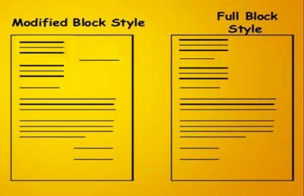

Slide 5
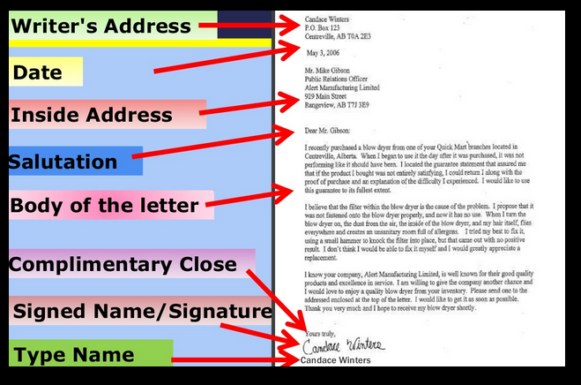

Slide 6

BODY OF A COVER LETTER
Introduction
  State the purpose of writing the letter.
Main Body
  Elaboration of the introduction.
Conclusion
  Tell them what you anticipate.

Slide 7
INTRODUCTION / OPENING PARAGRAPH
It should grab the attention of the reader.
Discuss the position you are applying for.
List your references or how you heard about the job
Highlight the main points you will focus on in the letter

Slide 8
SAMPLE OF OPENING PARAGRAPH
I am responding to your vacancy posted on www.jobs.com for a position as an Accounting Consultant. My experience and education make me an excellent candidate for this position.

Slide 9
MAIN BODY
Refer employer to certain points in your resume.
Emphasize your strongest qualifications and skills.
Show how these qualifications will benefit the company you are applying for.
You may provide examples of your achievements that have benefited previous companies or can benefit this one.

Slide 10
SAMPLE MAIN BODY
As you can see, I have had extensive work experience in office environments, the retail sector and service industries, giving me varied skills and the ability to work with many different types of people. I believe I could fit easily into your team.
I am a hard working person who pays attention to detail. I am flexible, quick to pick up new skills and eager to learn from others. I also have lots of ideas and enthusiasm. I'm keen to work for a company with a great reputation and high profile like [insert company name].

Slide 11
CONCLUSION
Ask for an interview.
Set up a possible time and date.
Be genuine and thank them for their time.

Slide 12
SAMPLE CONCLUSION
I would appreciate the opportunity of an interview to discuss my qualification and experience in detail. You may reach me at (+92)123456789 to arrange an appointment at a mutually convenient time. Thank you for your consideration.
*Sample cover letter on next slide.

Slide 13
Robyn A. Mathew
15 Elm Lane
Sometown, IN 55555
Home: (555) 555-5555
rmatthews@somedomain.com
May 6, 2010
Mr. Andrew Smith
Director of Operations
123 Company
15 Lafayette Way
Sometown, IN 55555
Subject: Applying for the post of Mechanical Engineer (Ref. Code: 12345).
Respected Mr. Smith:
Your job description for a Mechanical Engineer perfectly matches my qualifications, and I am very interested in the opportunity.
I have enjoyed a progressively responsible engineering career with ABC Manufacturing Co., and participated in the engineering of three major car model changes. I am experienced in all phases of new vehicle model development and implementation, from conception to production stages. Most recently, I have:
Developed process plans and layouts for seven additional car models.
Reduced ergonomic impact on production team members by designing new assist lift systems.

Slide 14
I have received repeated commendations from ABC Manufacturing Co. for my work quality, revenue contributions and commitment to achieving company goals, and I know I would be a valuable asset to your North American Division. My degree of Mechanical Engineering and work experience is parallel to the requirements of the job advertised.
Please feel free to call me at 555-555-5555 or send an email to rmatthews@hotmail.com to arrange a meeting. I look forward to speaking with you. Thank you for your consideration.
Sincerely,
Robyn A. Matthews
Enclosure: Resume

